Slide 1
FACEBOOK OAUTH
Guided By:
Dr. Vipulsir K Dabhi
Dr. Harshadsir B PraJapati
Developed by:
IT015-RAVI BHUVA
IT020-MITEN CHAUHAN
Dharmsinh Desai University FOT,Nadiad

Slide 2
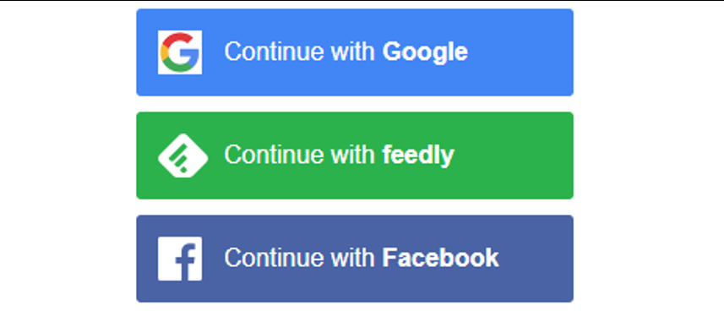
What is Facebook oauth?
OAuth is also used when giving third-party apps access to accounts like your Twitter, Facebook, Google, or Microsoft accounts. It allows these third-party apps access to parts of your account. However, they never get your account password.

Slide 3
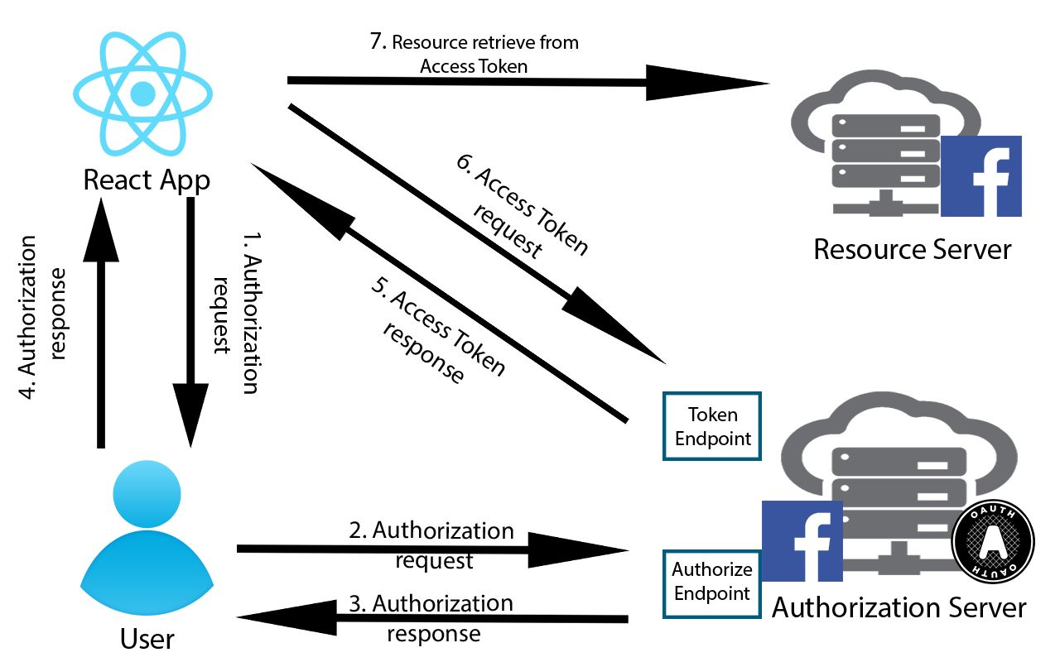
Stages Flowchart Diagram

Slide 4
How to Get Client ID from
Facebook Developer Console?
To start using Facebook authentication in your application, you need to create a developer account and get the Client ID. After that, you will be able to use Facebook API’s in your application and implement OAuth2 to enable Sign-In with the Facebook feature.

Slide 5
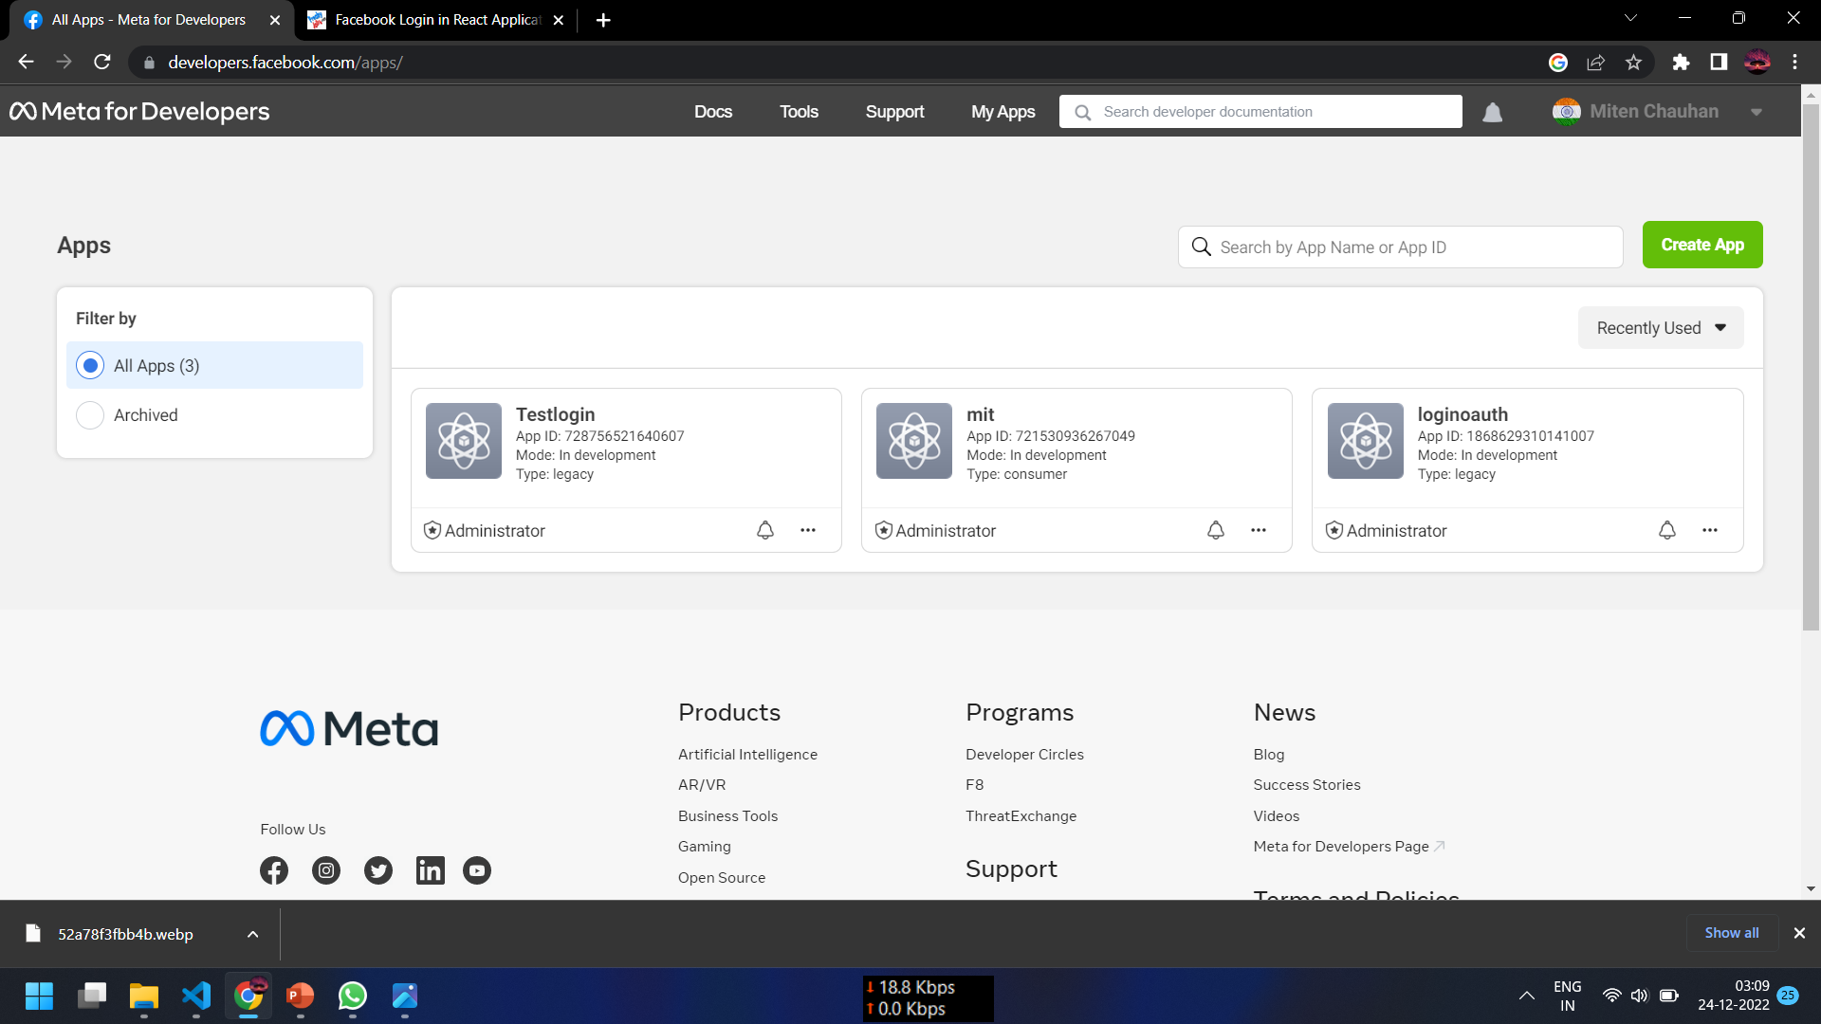
Step 1: Visit Facebook Developer Console and create an application by clicking the “Create App” button.

Slide 6
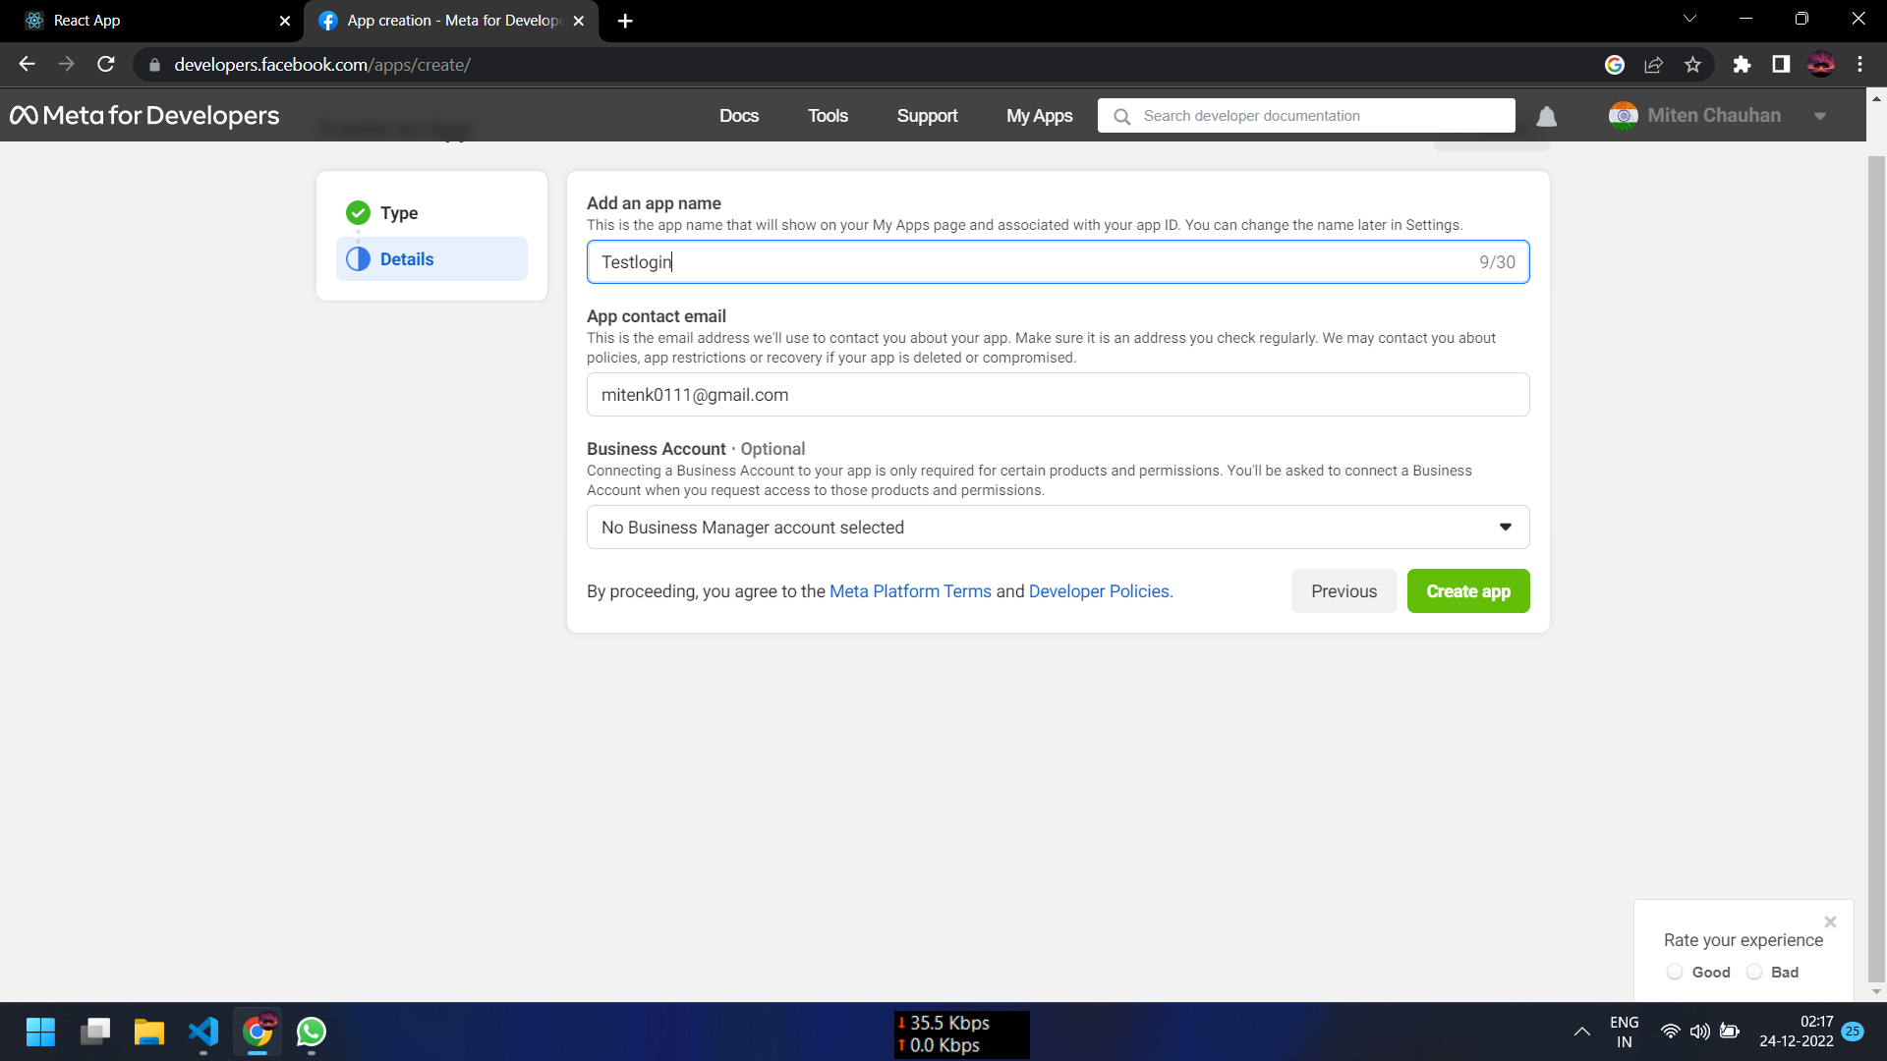
Step 2: Next, you will see a Create app popup, enter information including display name and contact email address.

Slide 7
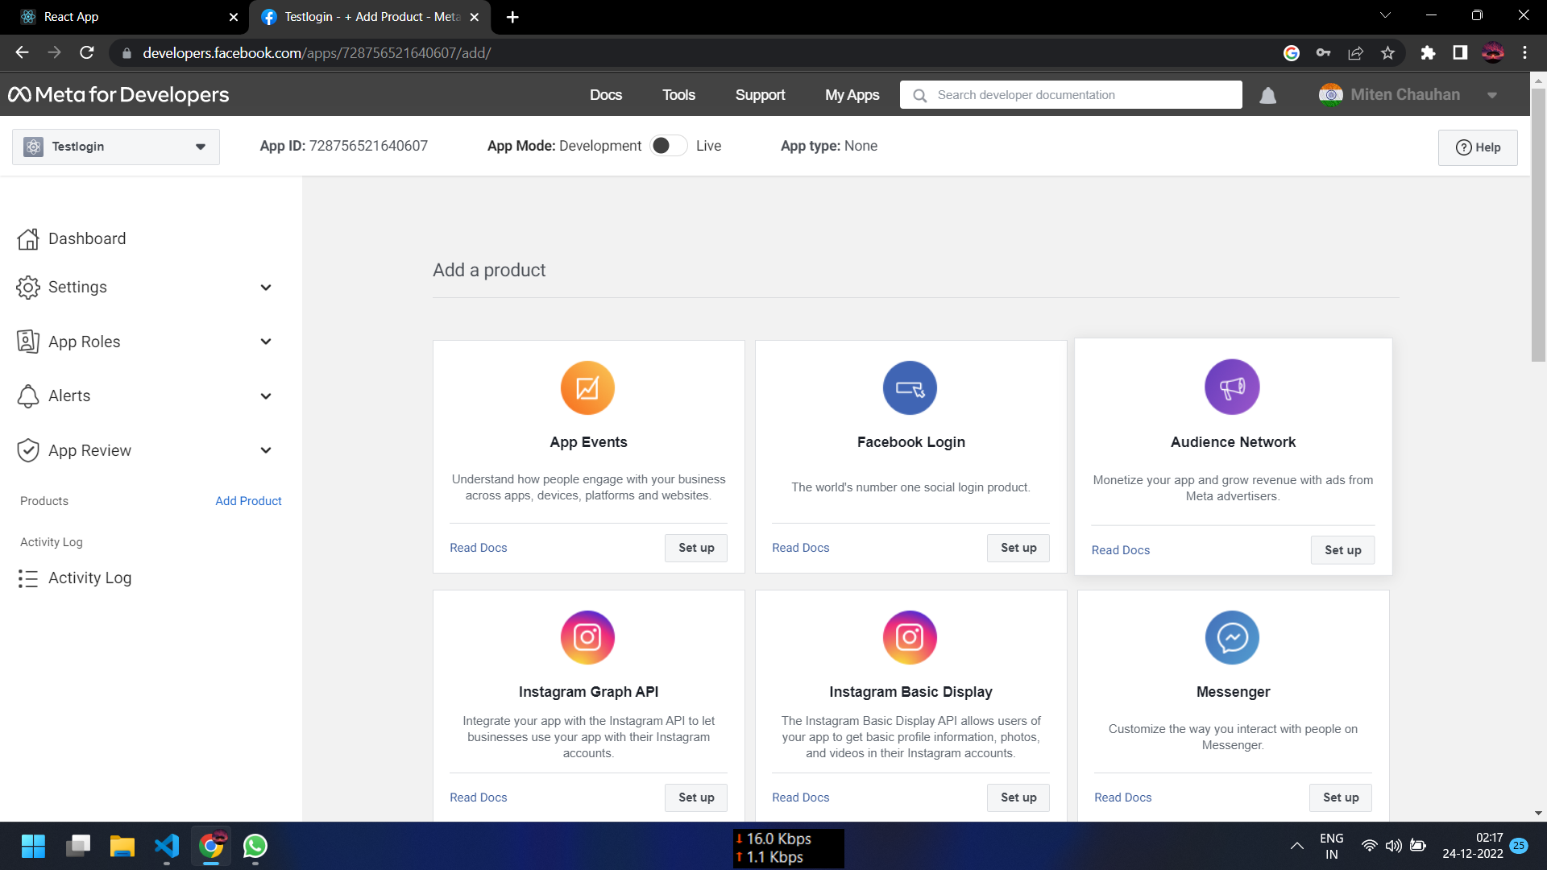
Step 3: On the next, screen you will see some cards to add to your application. Under the Facebook Login click on the Set Up button

Slide 8
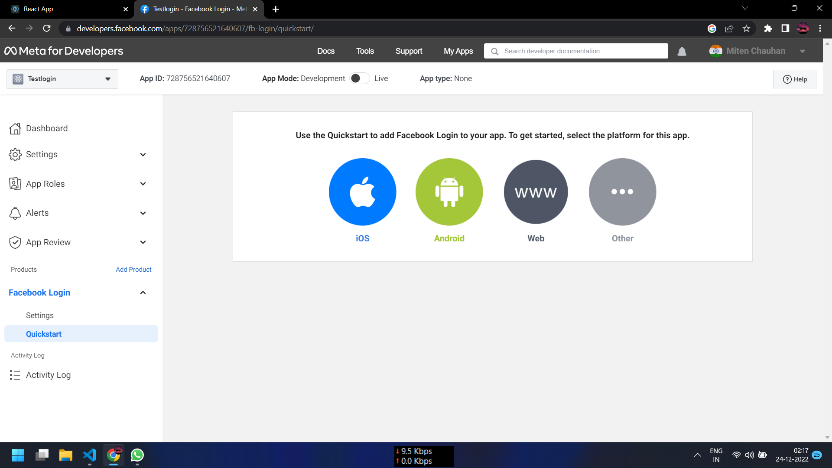
Step 4: Thereafter, you will see various platforms. Just click on the Web.

Slide 9
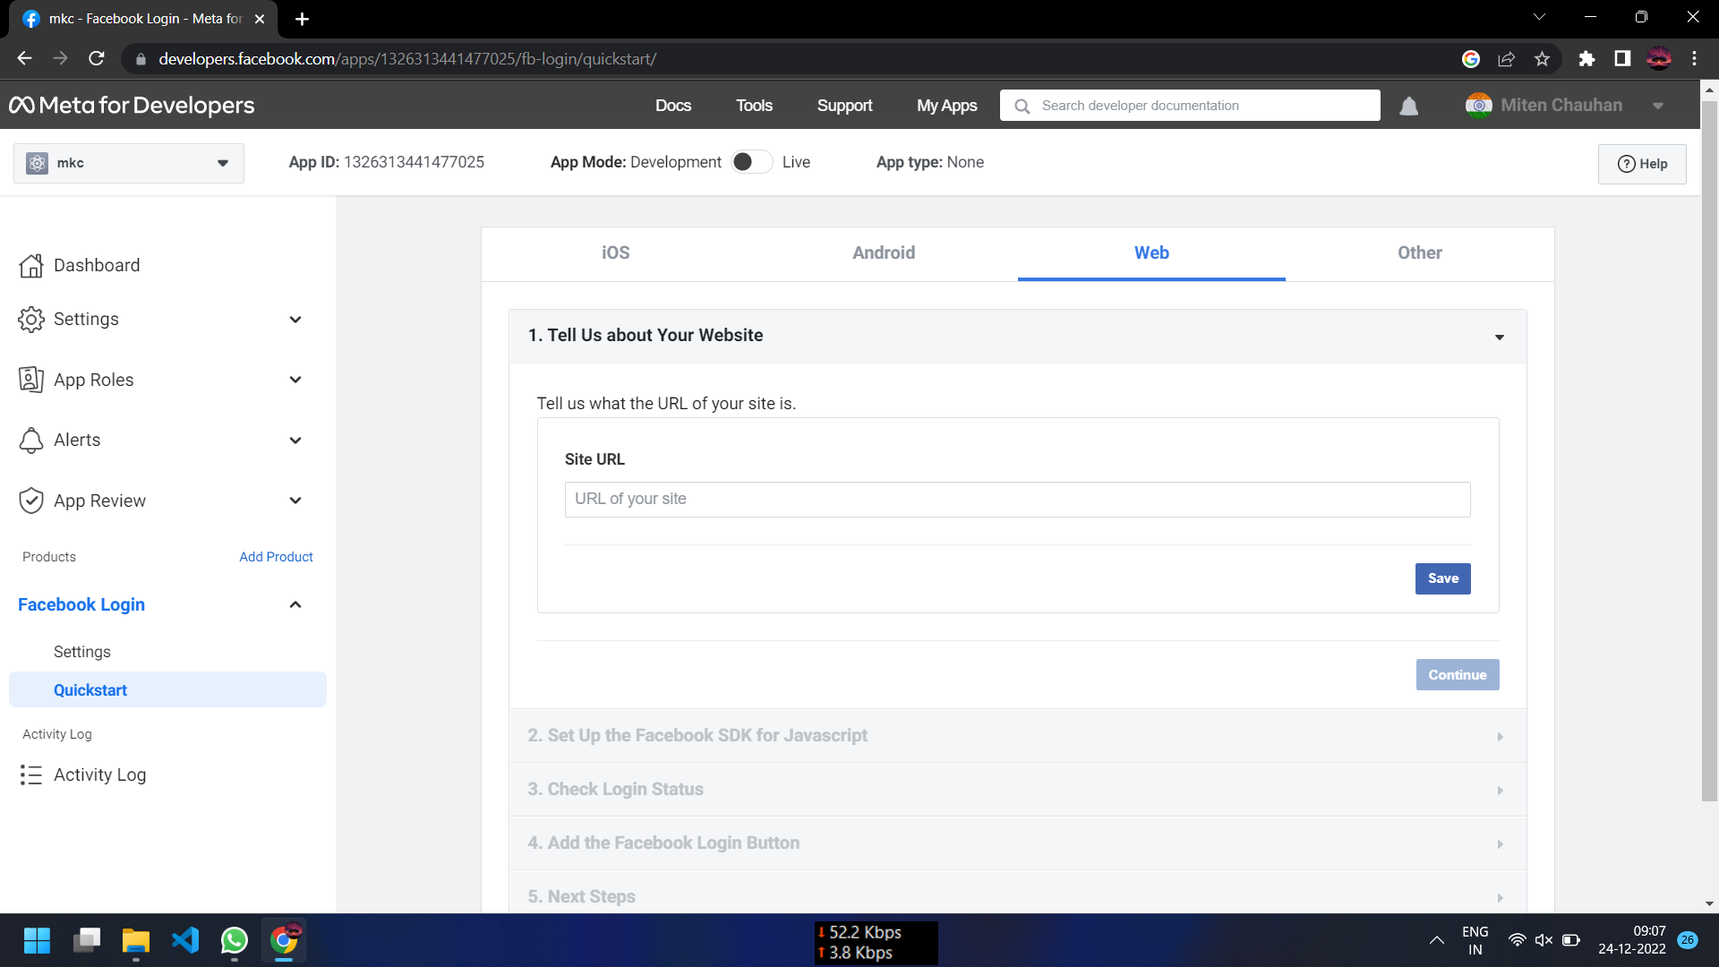
http://localhost:3000
Step 5: The next screen will ask to enter the URL of your application. For now, it will be http://localhost:3000

Slide 10
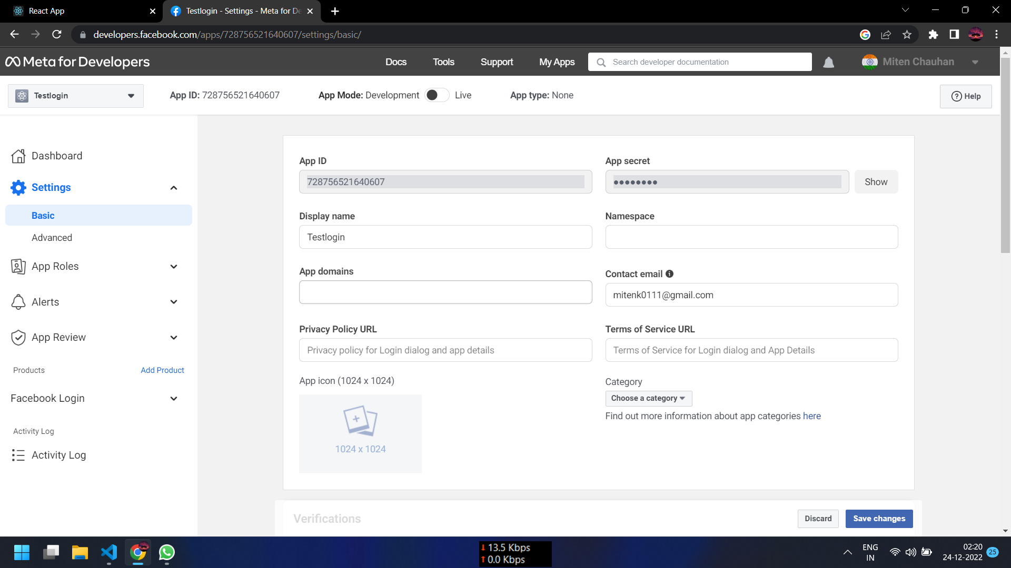
Step 6: Clicking on the Save button will create an application. You can see the application by clicking the My Apps link on top. Under the application name, you will find the App ID.

Slide 11
Step 7: Copy the App ID and Save it.

Slide 12
How to Add Facebook Login in
React Application?
Step 1: Create React App - npx create-react-app react-facebook-login-app fouth
Step 2: Install React Facebook Login Package - npm install react-facebook-login
Step 3: Create Facebook Login Component - Facebooklogin.js
Step 4: Add Facebook Login Component – App.js
Step 5: Run React Application – npm start

Slide 13
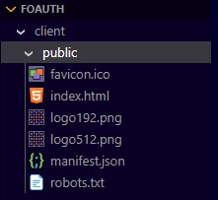
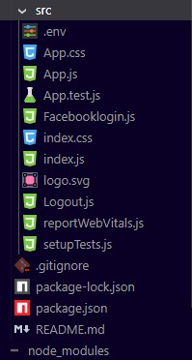
Project Files

Slide 14
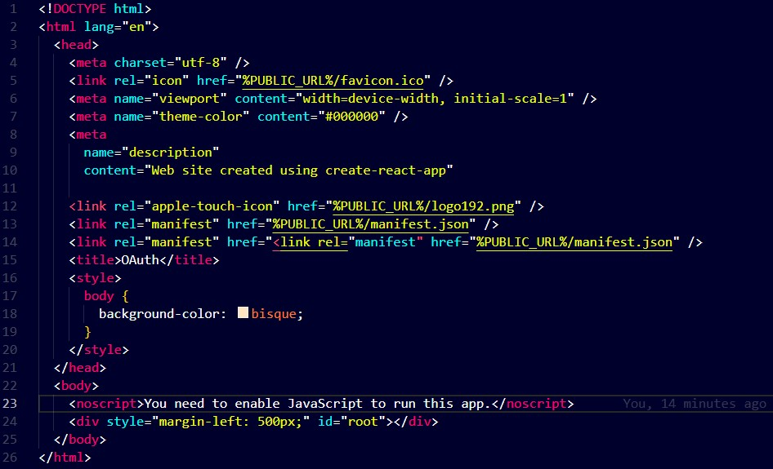
Index.html

Slide 15
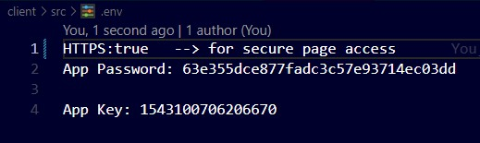
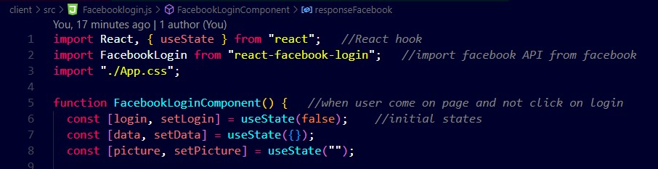
.env and Facebooklogin.js

Slide 16
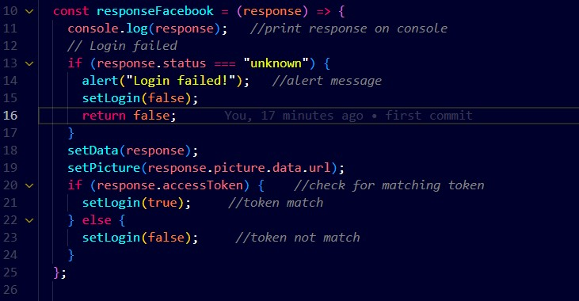
Facebooklogin.js

Slide 17
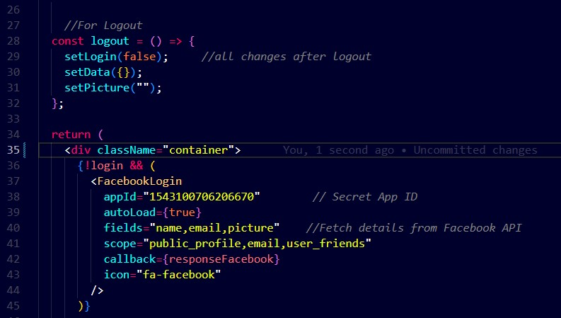
Facebooklogin.js

Slide 18
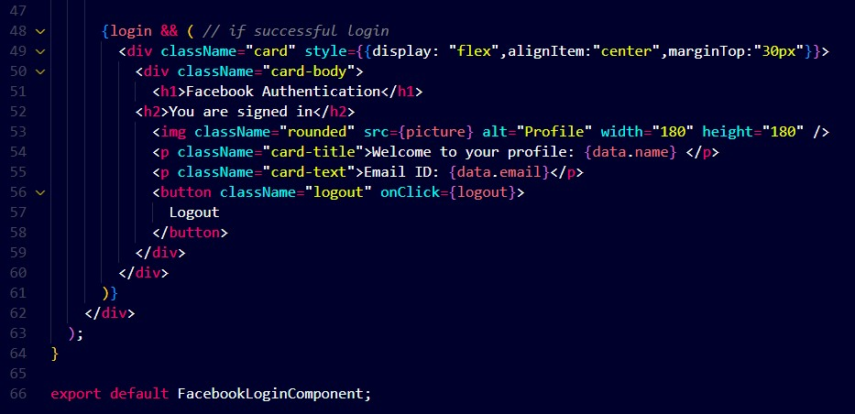
Facebooklogin.js

Slide 19
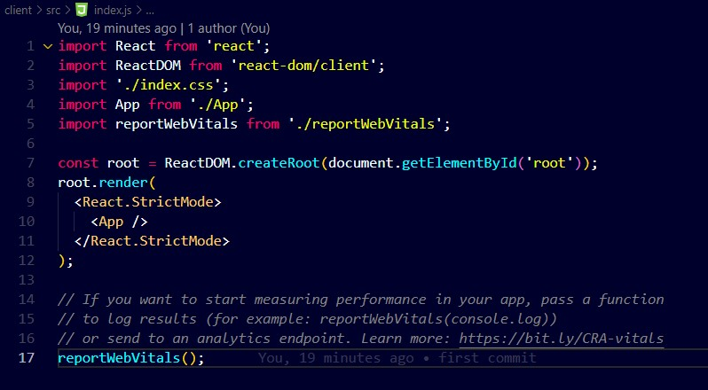
Index.js

Slide 20
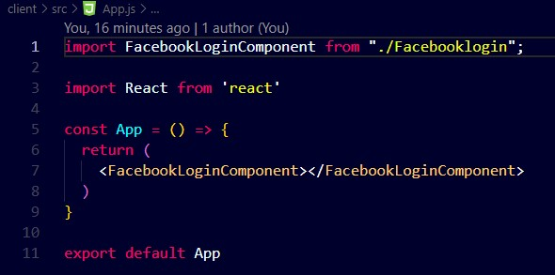
App.js

Slide 21
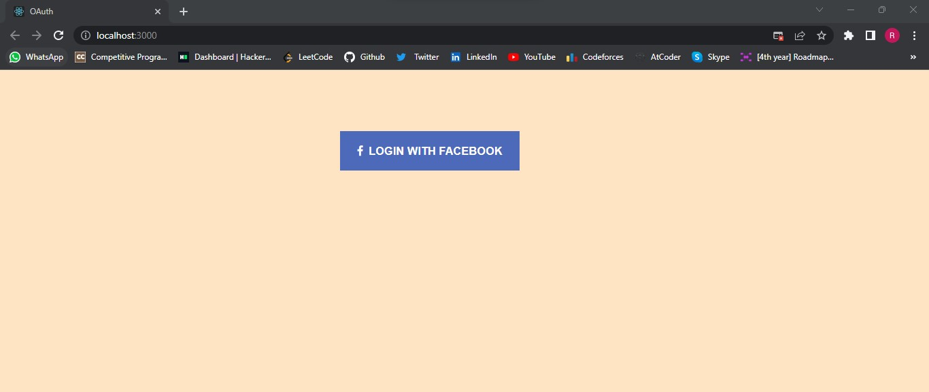
Facebook Authentication page
After Click On This Button

Slide 22
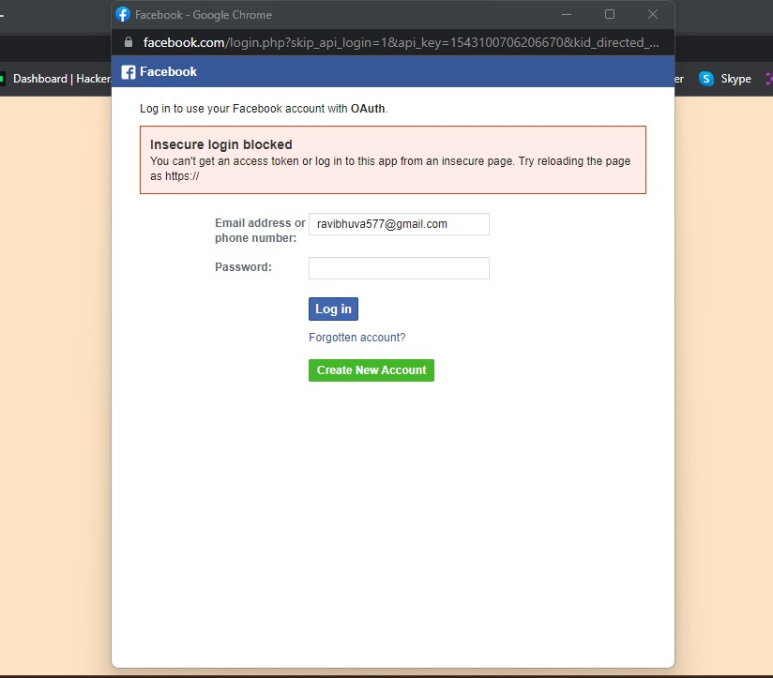
For New User

Slide 23
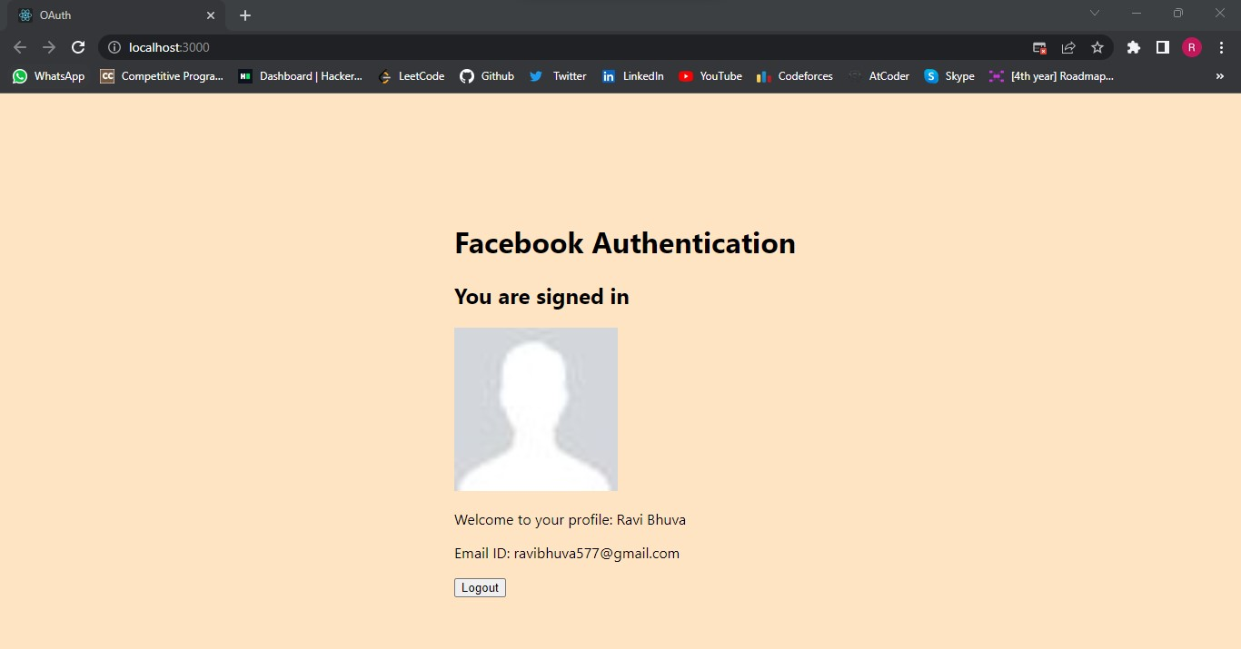
After Successfully Login
After Press Logout Button

Slide 24
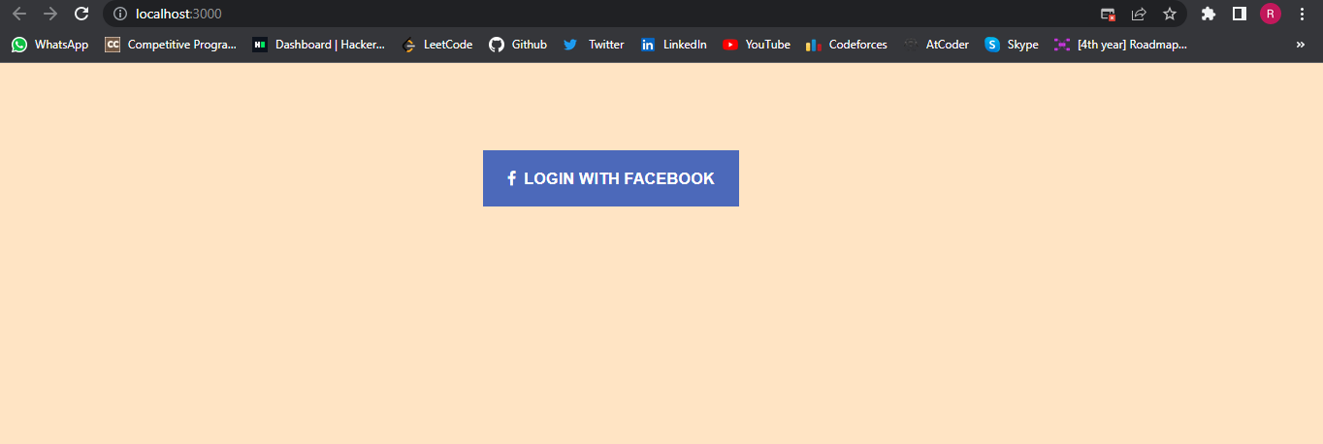
After Logout

Slide 25
Project Source
Github Link:
https://github.com/ravibhuva003/FOAuth
Facebook API:
https://developers.facebook.com/
Thank You

